Slide 1

JAWAHARLAL NEHRU NATIONAL COLLEGE OF ENGINEERING DEPARTMENT OF COMPUTER SCIENCE AND ENGINEERING BLUEBAYCOFEE SHOP MANAGEMENT SYSTEM
Yeshwanth. P 4JN17CS111
Sudhvina A.S 4JN17CS100

Slide 2
PROBLEM STATEMENT:
THE MAIN PURPOSE OF THE SYSTEM IS TO MANAGE THE CUSTOMER DETAILS, EMPLOYEE DETAILS ,ORDERING AND BILLING DETAILS OF BLUEBAYCOFFEE SHOP AND ONE MUST GET SATISFIED BY THE UPDATE RESULTS OF THE SYSTEM DURING ADD/DELETE OPERATION ON THE ITEM DETAILS

Slide 3
ABSTRACT:
This project illustrates the design and implementation of a BluebayCoffee shop management system. The main aim of the project is the management of the BluebayCoffee shop. This is done by creating the database of available products in the shop. The database is then connected to the main program by using interconnection of the C# and the database that has already been created. Here a software is designed which keeps the record of the all products, customer, employee and billing details of the shop. It is fed with the information of the products available in the shop And it keeps updating the record of the products sold from the shop.

Slide 4
OBJECTIVE OF THE PROJECT:
This pizza store management software is so designed as to ease the work load of pizza store managers.
The main feature includes employee, items and store control, purchasing and customer management.
This system can be used by a managers to automate the process of manually maintaining the pizza store
This project is basically updating the manual product inventory system to automated inventory system so that the organization can manage their record in efficient and organized form.

Slide 5
SYSTEM REQUIREMENT SPECIFICATION:
SOFTWARE REQUIREMENTS:
Operating system - Windows 10
Database - Visual Studio 2019
Front end - C#
Platform - Visual Studio

Slide 6
REQUIREMENT ANALYSIS
In manual system it takes more time for maintaining and calculating stock details and bill generations this project has all requirements to efficiently reduce the tedious work load
By providing following processes:
The manager can login to system with correct user id and password to add/delete details about products, customers, employees and orders.
Manager can view details about items and its price information.
For ordering products, details will be available.
manager can insert into item and add order details to system. Here system will take care of updating the item details itself and generates the order with system calculation hence reduces manual work and time required

Slide 7
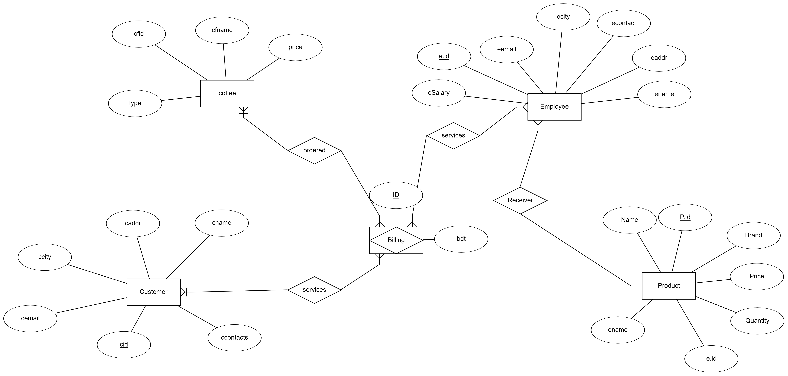
ENTITY RELATIONSHIP DIAGRAM

Slide 8
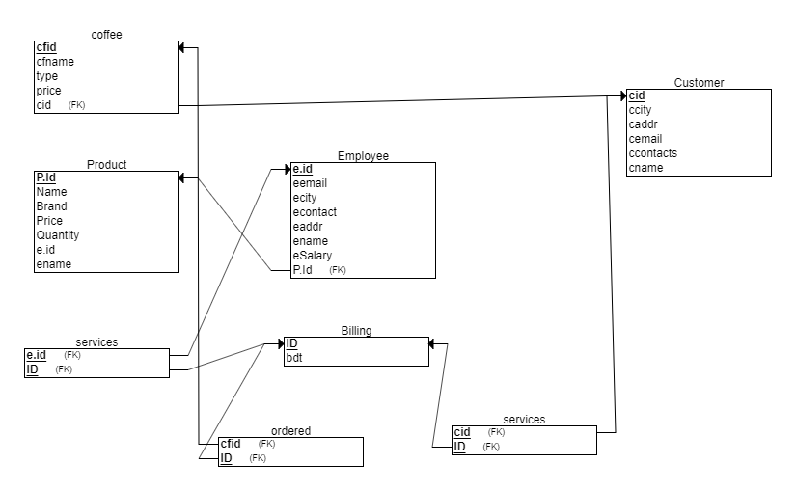
SCHEMA DIAGRAM

Slide 9
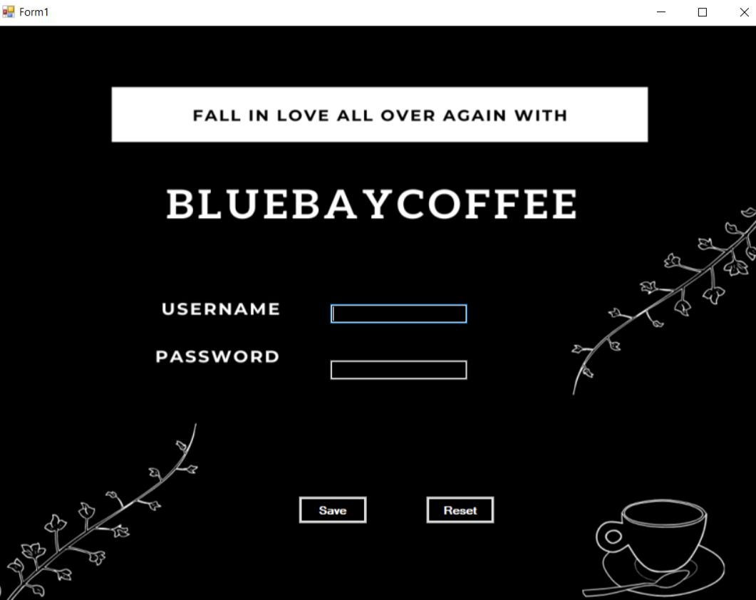
FRONTEND TABLES

Slide 10
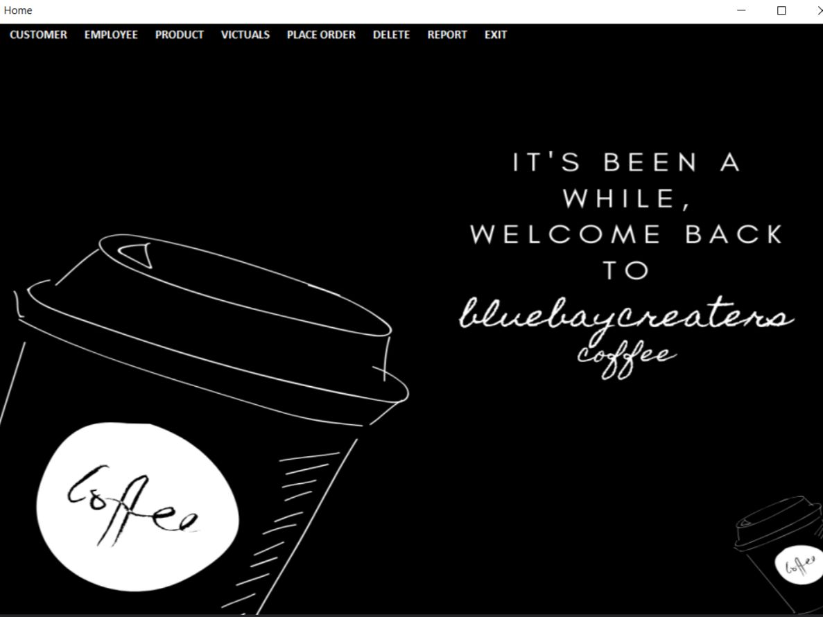

Slide 11
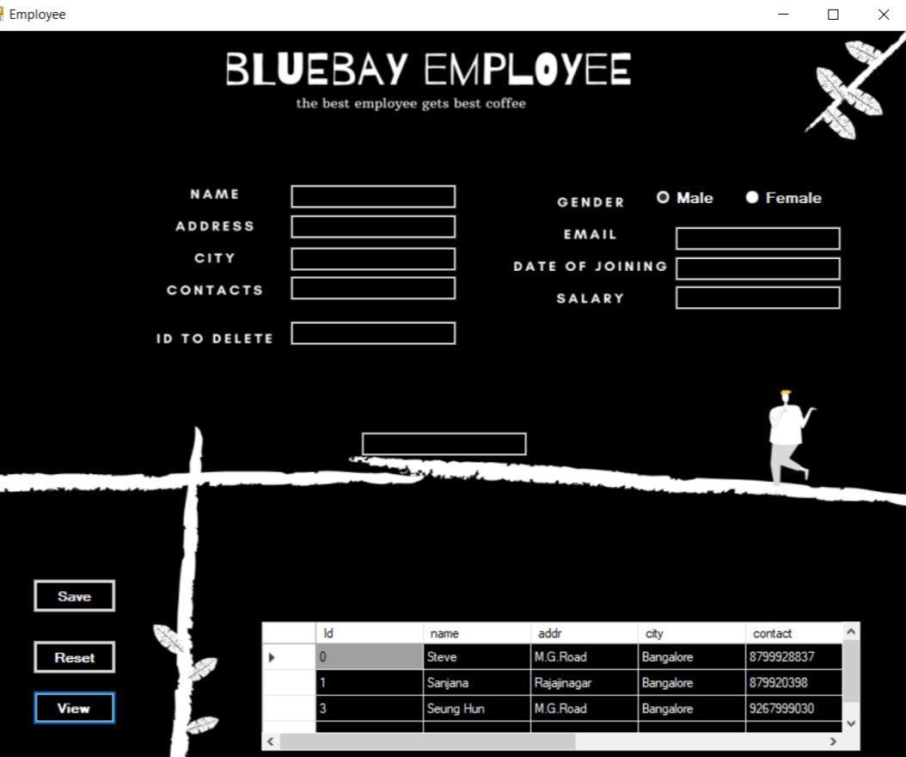

Slide 12
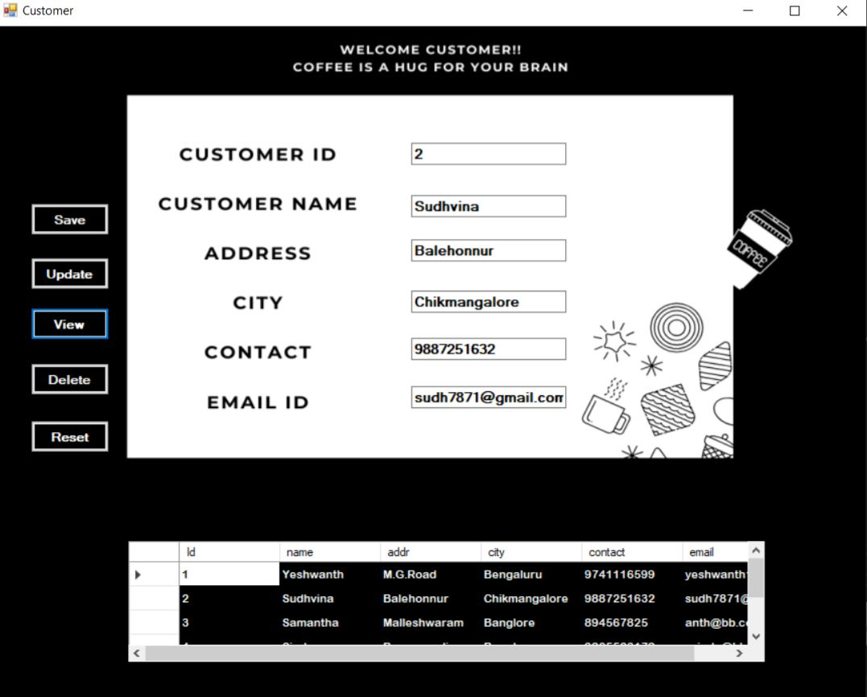

Slide 13
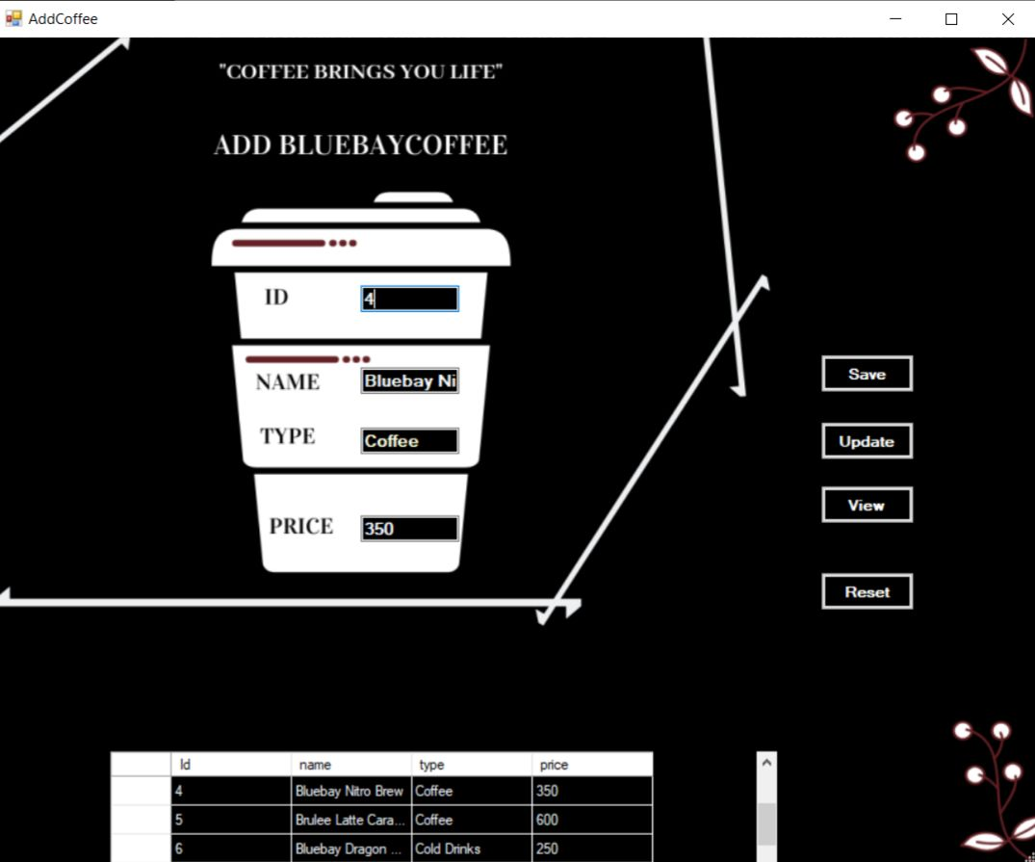

Slide 14
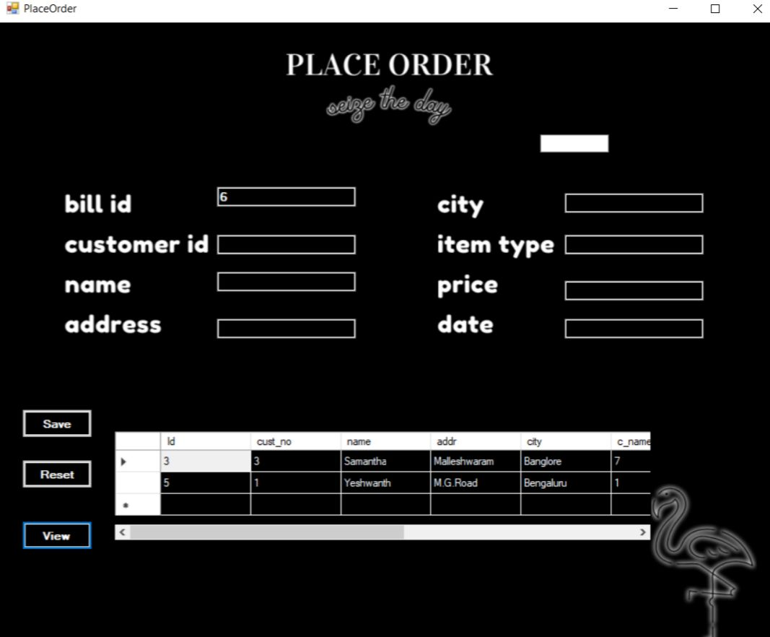

Slide 15
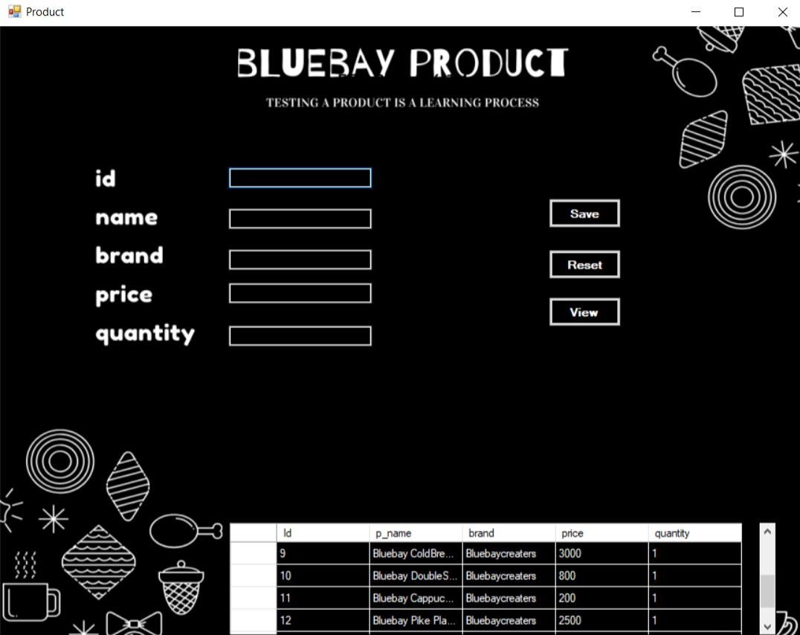

Slide 16
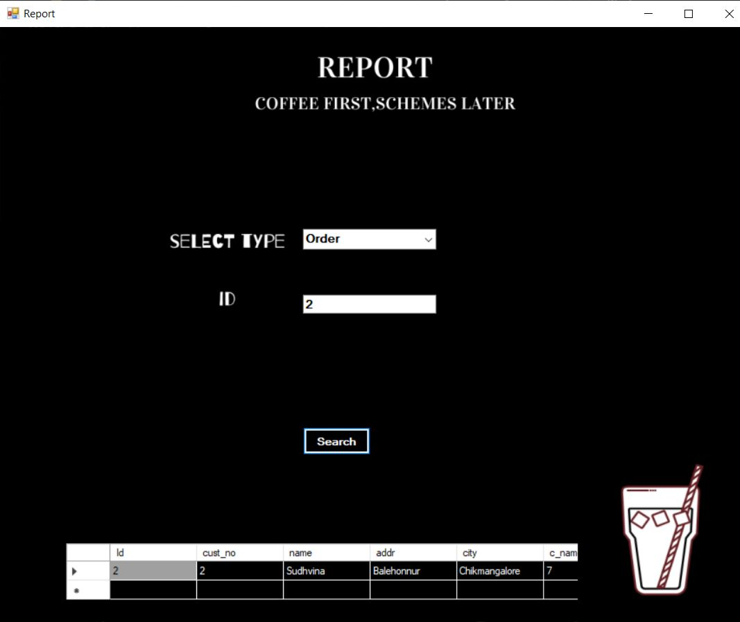

Slide 17
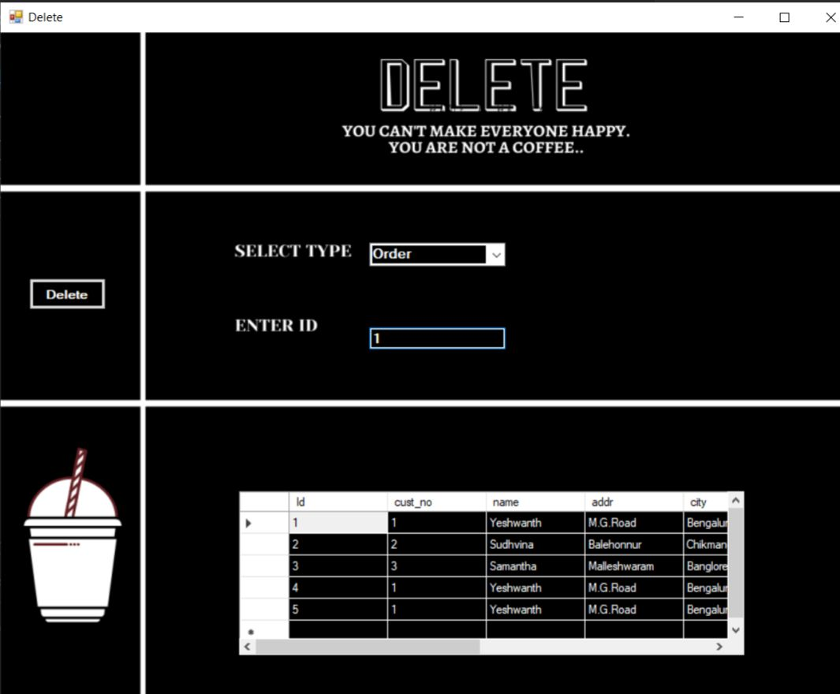

Slide 19
FUTURE SCOPE OF THE PROJECT
The project “BLUEBAYCOFFEE SHOP MANAGEMENT SYSTEM” has been created with the intention of providing a company head with application which helps to store the coffee product details.
All the requirements specifications were followed as far as possible and few additional features were added that can make the application friendlier and less complicated.
The project “bluebaycoffee management system” has been developed with the proper guidance from the manager.
We hope that “bluebaycoffee management system” fulfills all the needs in possible manner.

Slide 20
CONCLUSION
Our project satisfies the needs to manage the BLUEBAYCOFFEE SHOP. Our project satisfies most of the requirements of THE COFFEE SHOP. User-friendly code is been used as to support user-friendly platform for shopping PIZZA. The project which we have done makes it easy to ORDER, save time and money.

Slide 21
REFERENCES:
C# 7.0 Pocket Reference: Instant help for Beginners by Ben Albhari and Joseph Albhari.
Raghu Ramakrishnan, and Gehrke, “Database management systems”, McGraw Hill, 3rd Edition, 2014,
C# for Dummies by John Paul and Bill Sempf 1st Edition, Kindle Edition.

